Slide 1
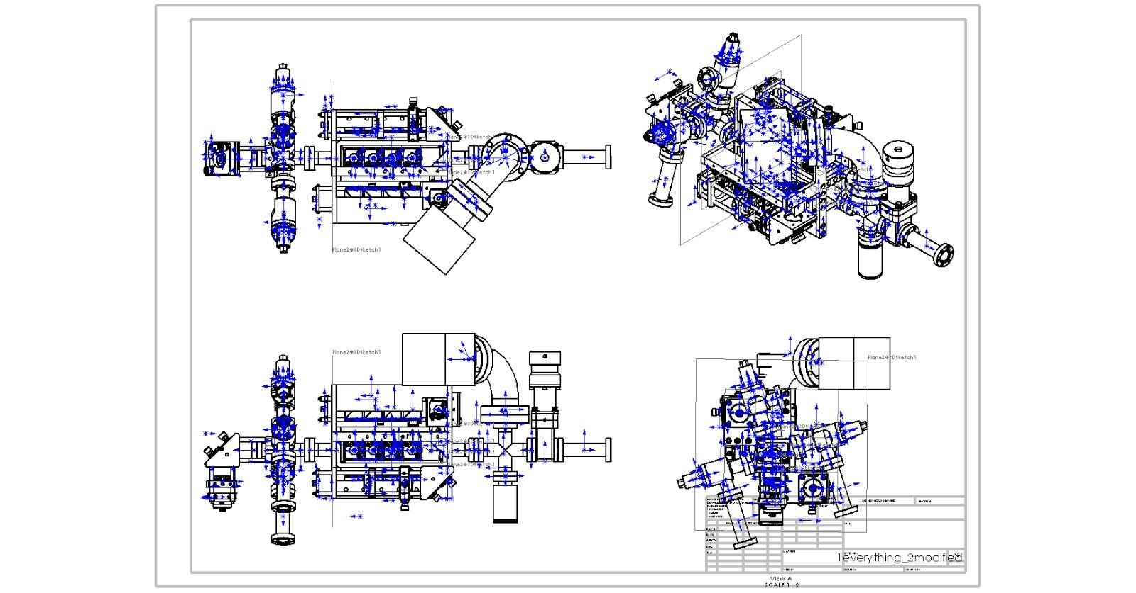
Rb oven
Ion pump
Push beam
optics
Gate valve
K oven
Cell
Mounting crosses
To 3-D MOT
Rotatable flag

Slide 3
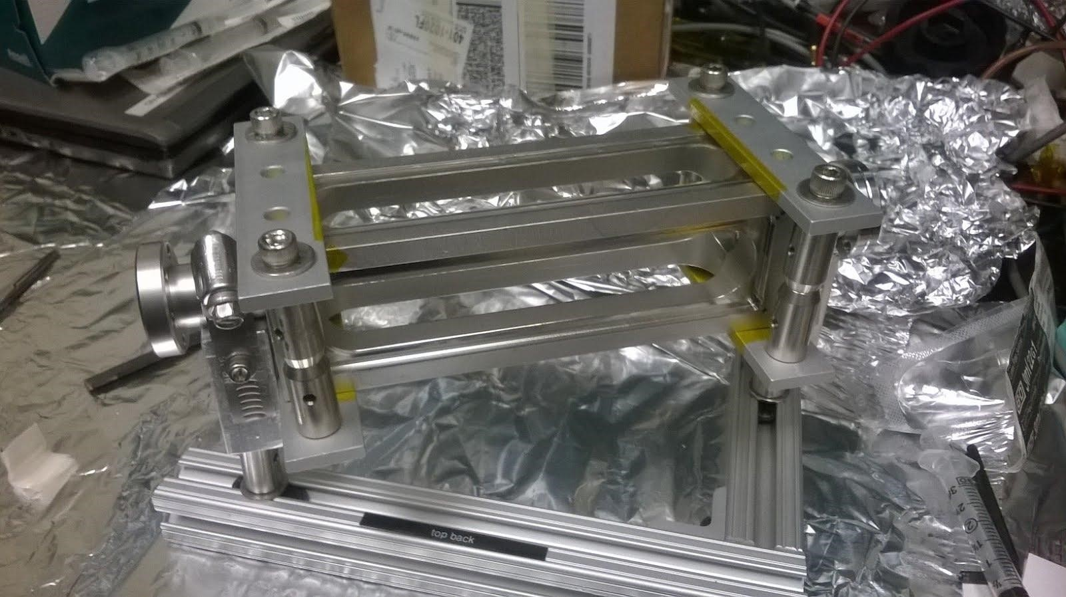
Clamps
Rotatable
mini conflat
connector
Mini conflat
connector
AR coated windows
Stainless Cell

Slide 4
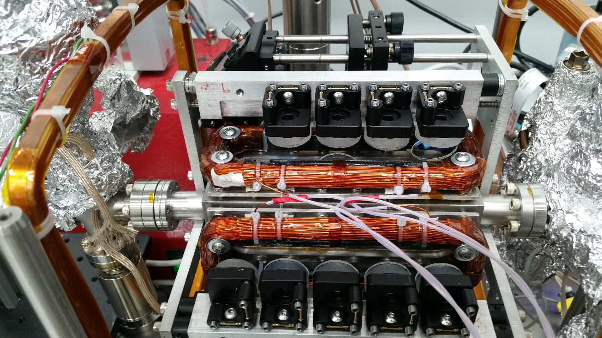
biasZ coils
Retro-reflection
mirrors
Quarter
waveplates
Quad coils

Slide 5
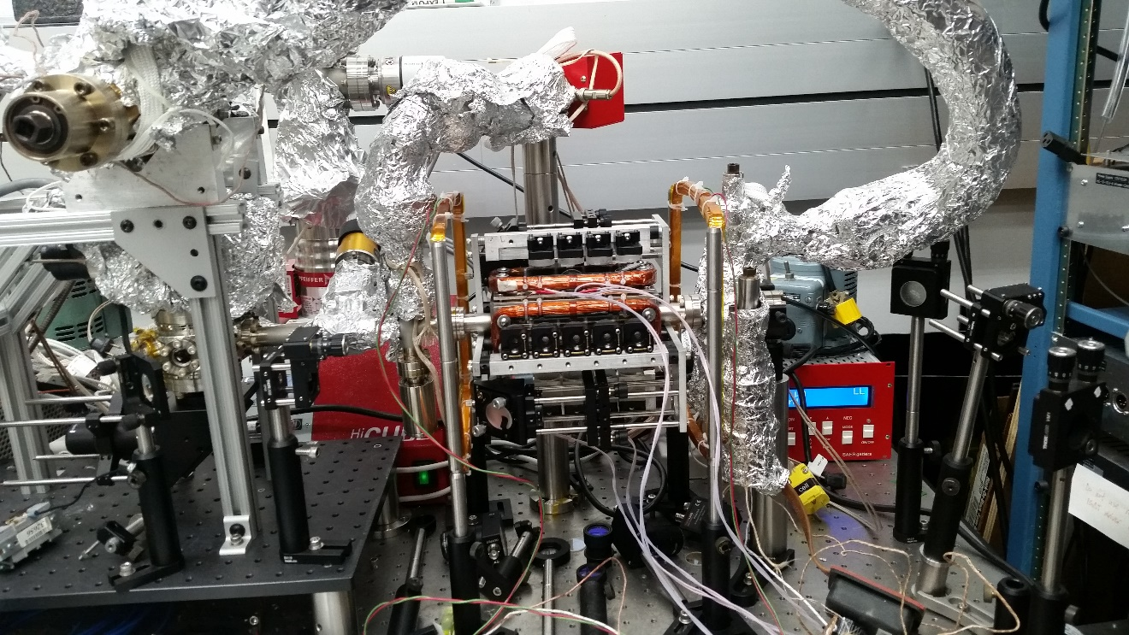
Ion pump
BiasZ coils
Quad coils
Retro-reflection
mirrors
Push beam
optics
Gate valve
Test chamber
Flag
Periscope
mirror
Ovens

